Slide 1
BIA 660 Final Project
Extract H-index and G-index From Multiple Web Resources
Team 1
Fubin Mo Jichen Dai
Yuan Yang Qihao Zhang

Slide 2
AGENDA
Object
H-index & G-index
Tools
Methods
Conclusion

Slide 3
Object
The purpose of this project is to add a column to verify that each article meets the criteria. In order to meet this condition, we believe that the academic achievement of the first author of this article can reflect the approximate extent of this article.

Slide 4
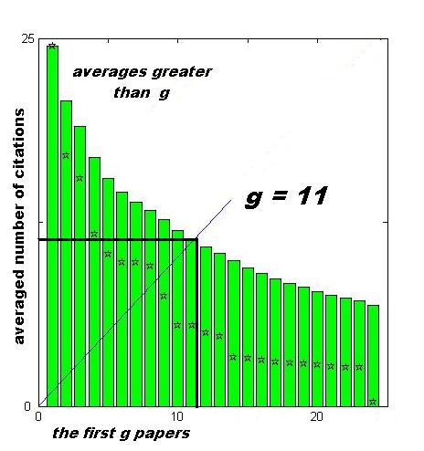
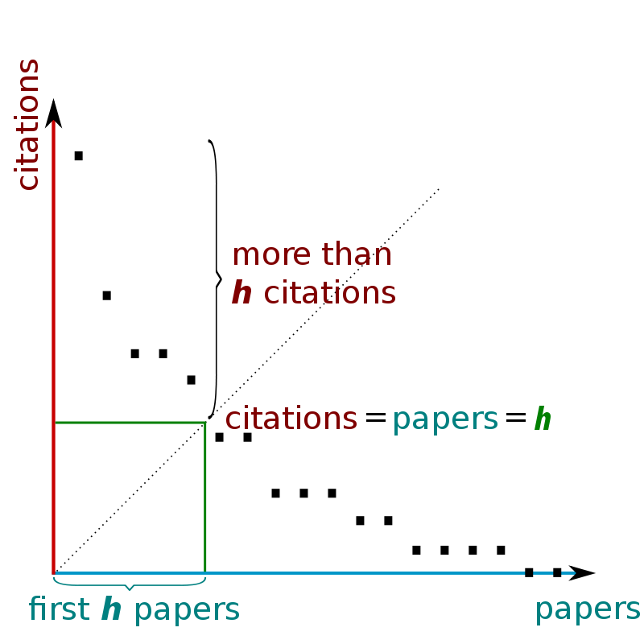
H-index & G-index
H Index(high citations)
The maximum value of h such that the given author/journal has published h papers that have each been cited at least h times.
G Index
The largest number n of highly cited articles for which the average number of citations is at least n.

Slide 5


Tools

Slide 6
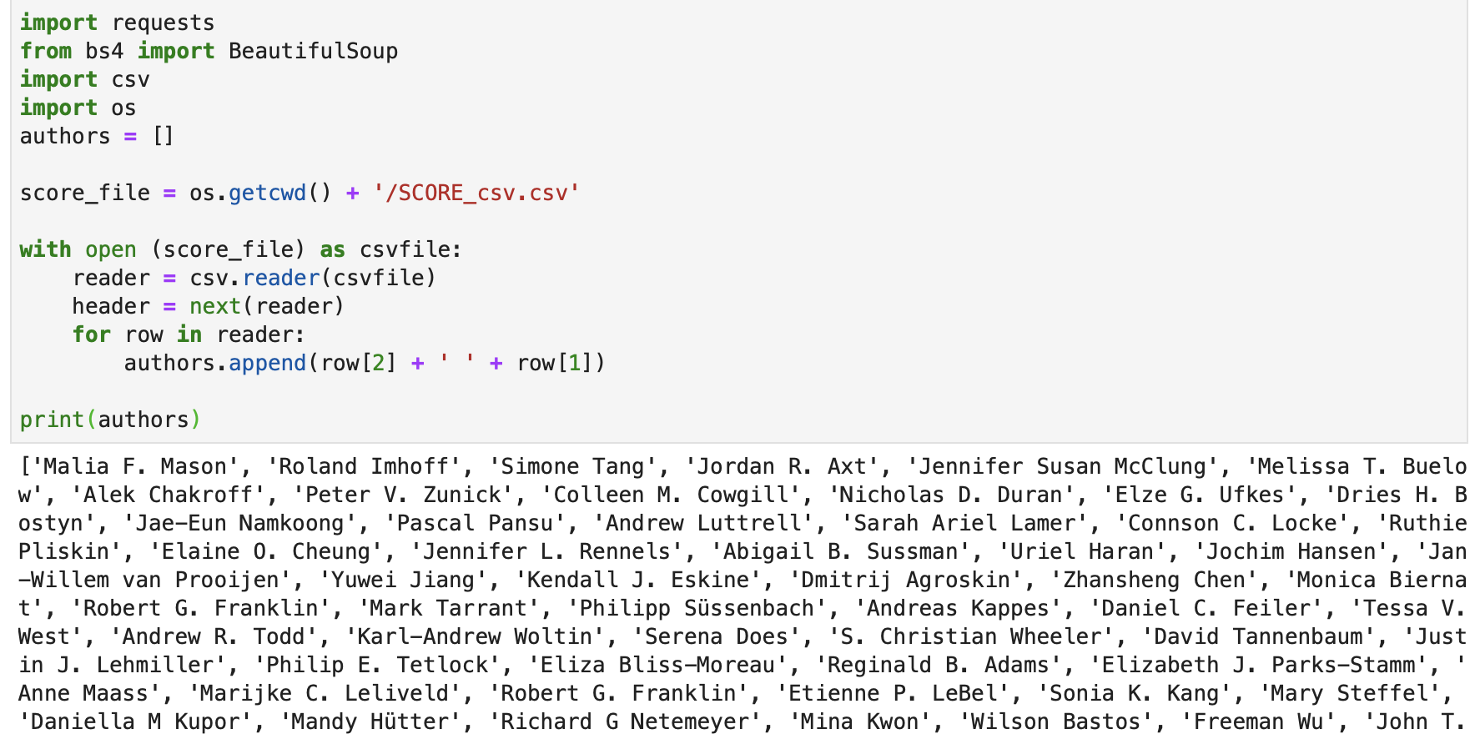
Methods -- (1) Scraping From Google Scholar
extract all the first author of every article

Slide 7
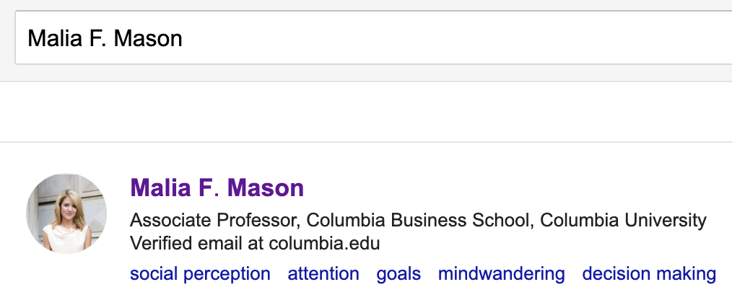
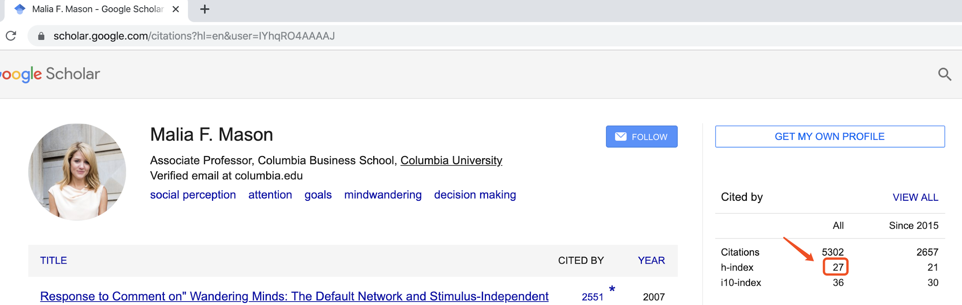
Query google scholar according to the author's name, and then extract the h index on the interface.

Slide 8
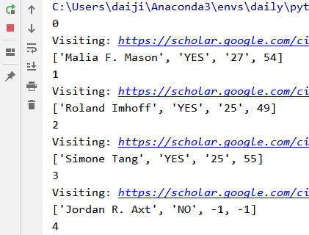
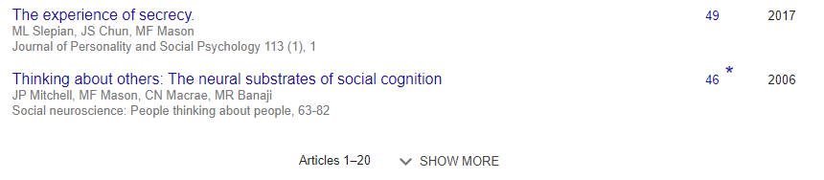

Calculate G-index
Using Selenium to
Turn page automatically

Slide 9
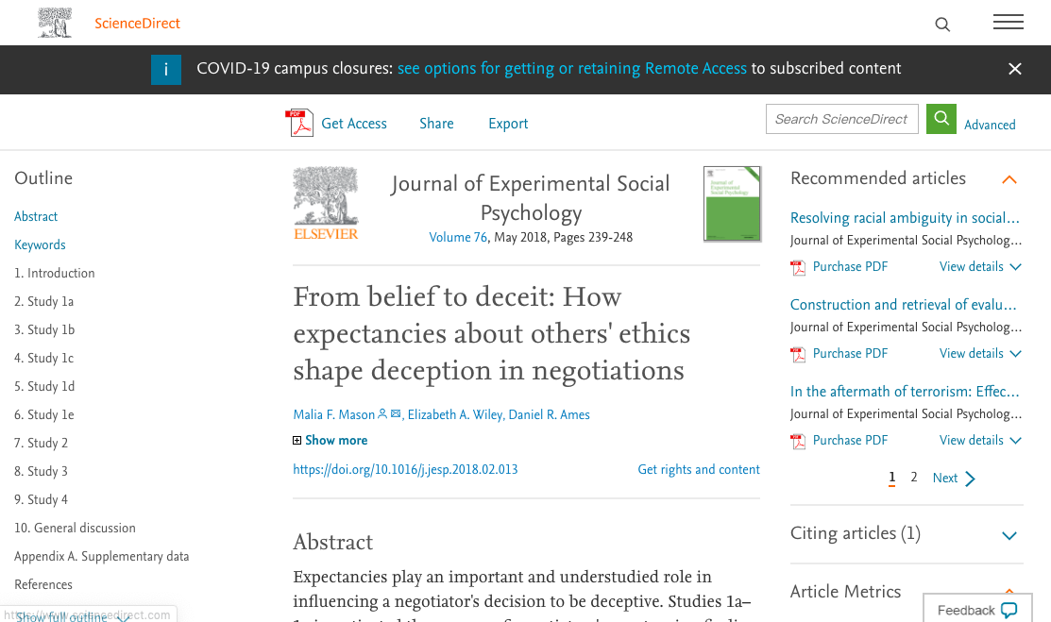
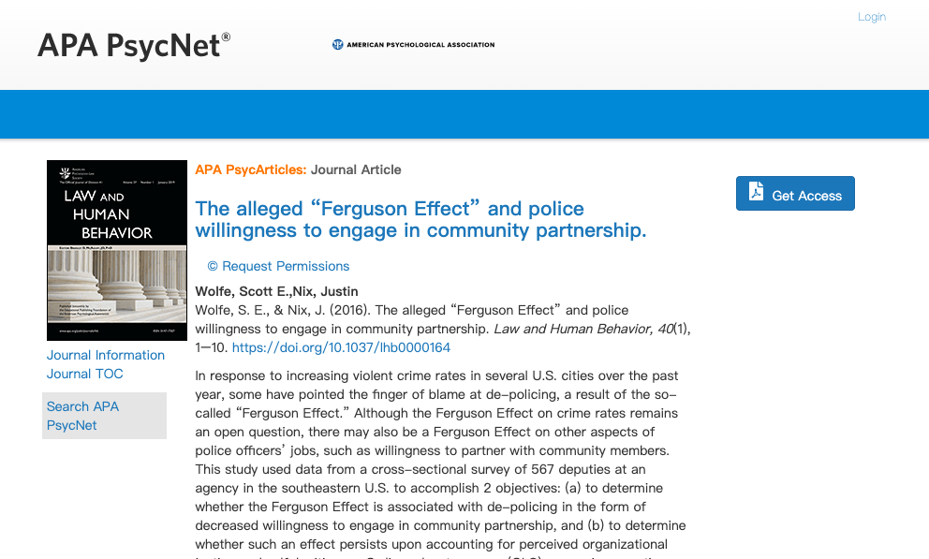
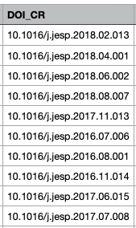

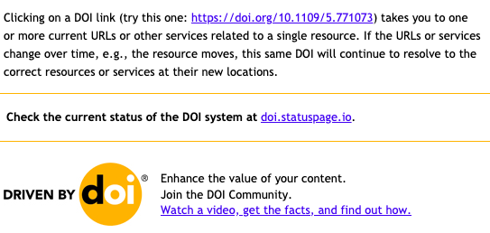

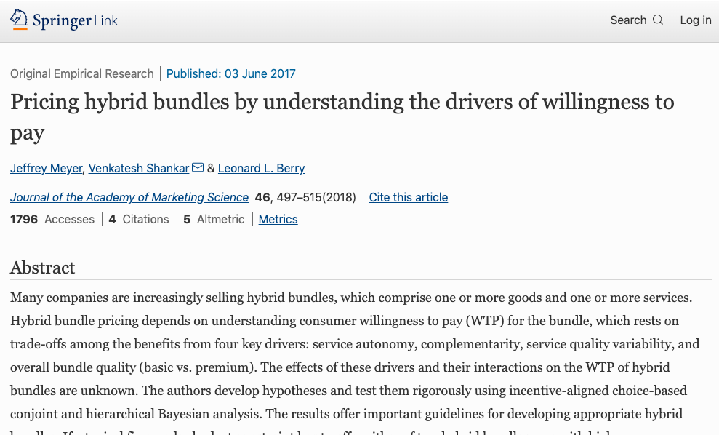
Methods -- (2) Scraping Through DOI Name
https://doi.org/XXXX
DOI column in dataset
Different Websites

Slide 10
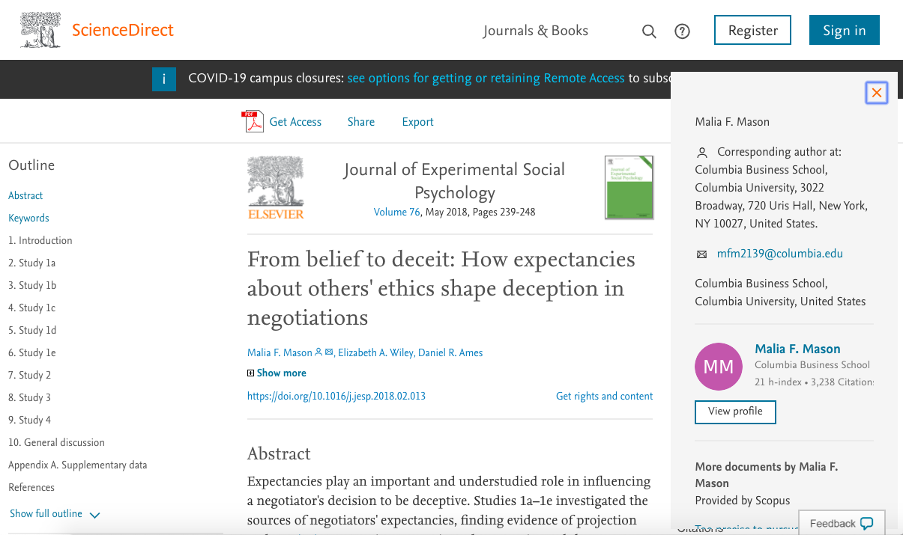

Slide 11
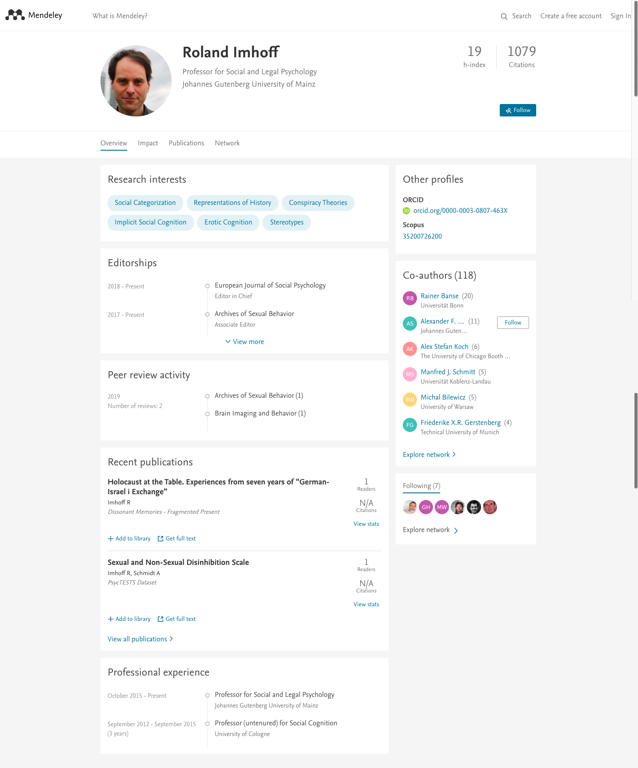
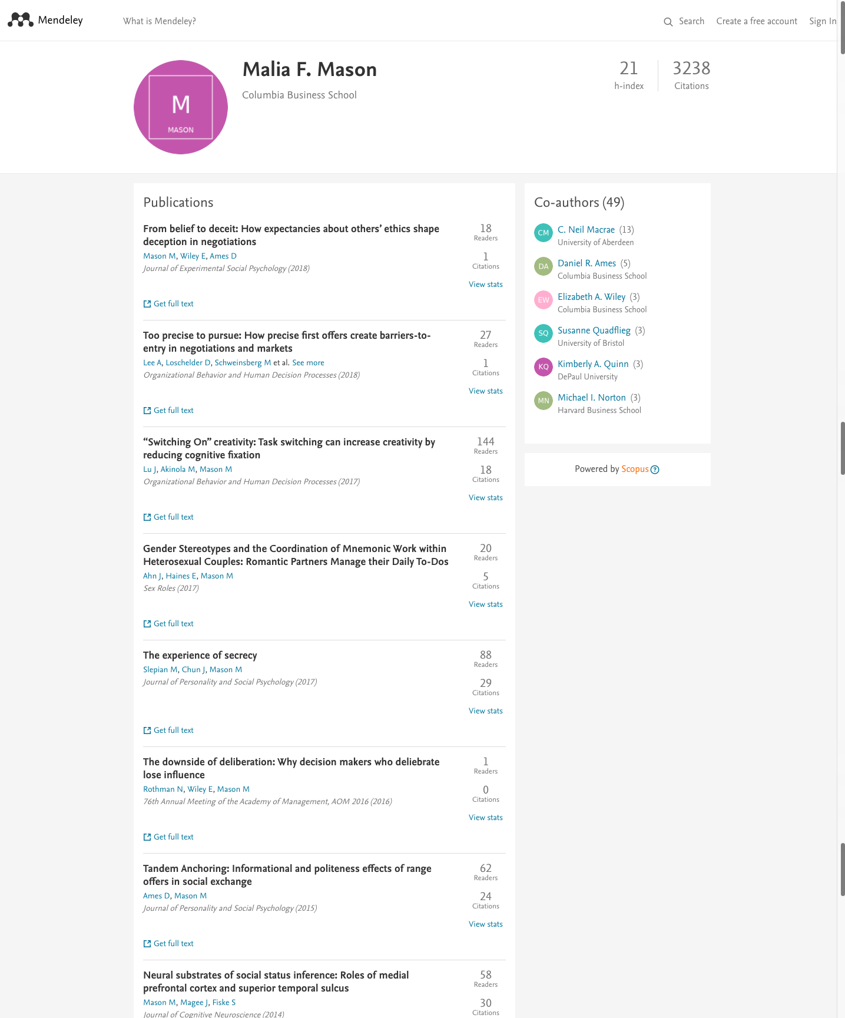


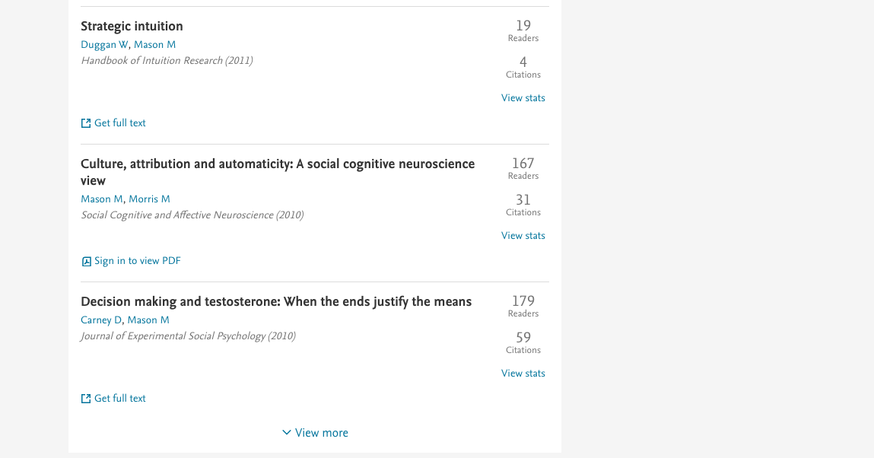

Slide 12
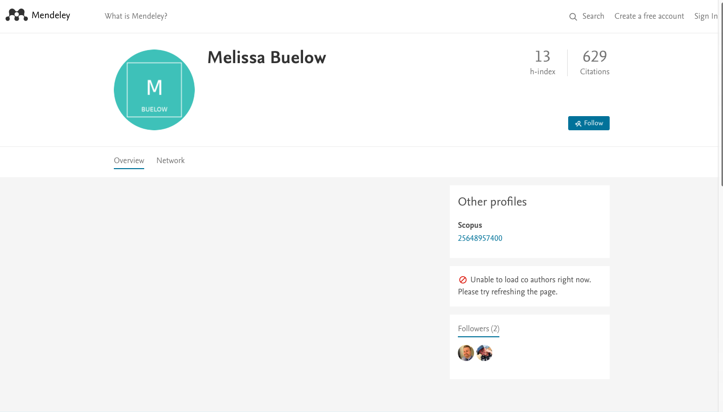

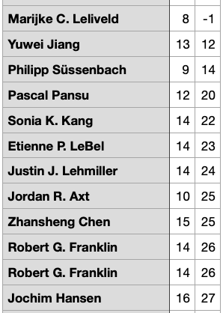

Slide 13


Methods -- (3) Scraping By Authors’ ORCID
ORCID provides a persistent digital identifier that you own and control, and that distinguishes you from every other researcher.
Search ORCID is more accurate than search name.

Slide 14
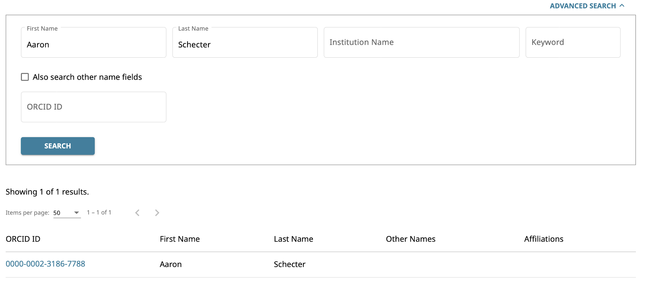
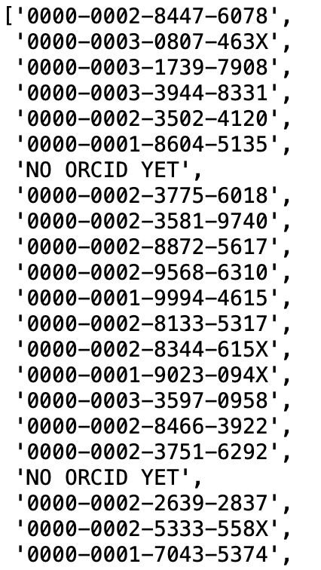
Search result

Slide 15
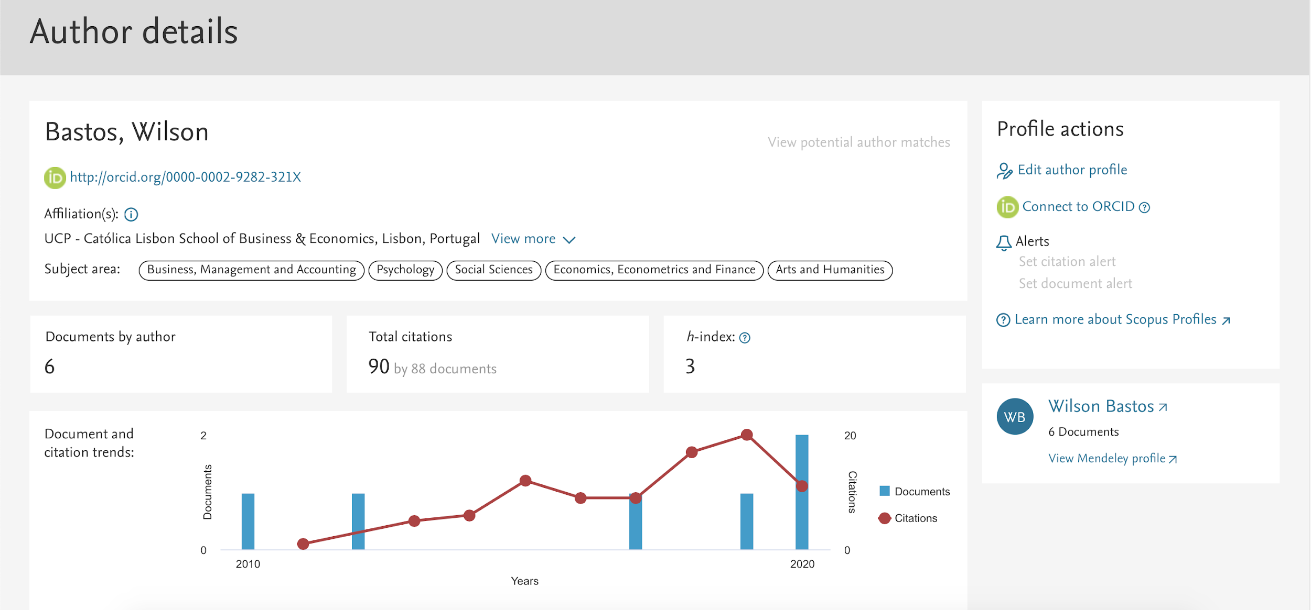
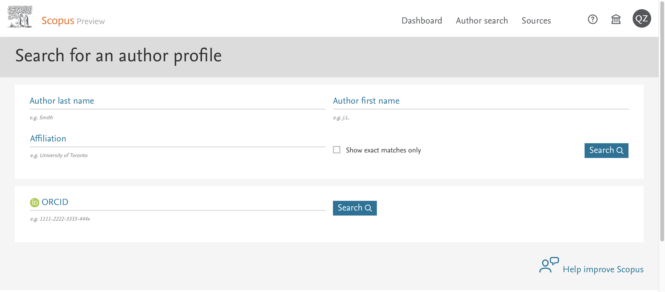
Scopus is the largest abstract and citation database of peer-reviewed literature: scientific journals, books and conference proceedings.

Slide 16
Conclusion
Used three different methods to scrap the h-index and g-index and combined the results together.
Used Selenium & BeautifulSoup instead of the request package.
By combined the three results, we got the h-index and g-index of almost ALL authors in the dataset.

Slide 17
Thank you!

